Slide 1

Distributed, Concurrent, and Independent Access to Encrypted Cloud Databases
Team Members:
A.S.S.BHARADWAZA (11T81A0525)
T.NAVEEN KUMAR (11T81A0517)
P.SAI ARUN KUMAR (11T81A0528)
Under the guidance of
Mr. V. Ramakrishna, M.Tech,
Asst. professor, HOD, CSE Dept.

Slide 2
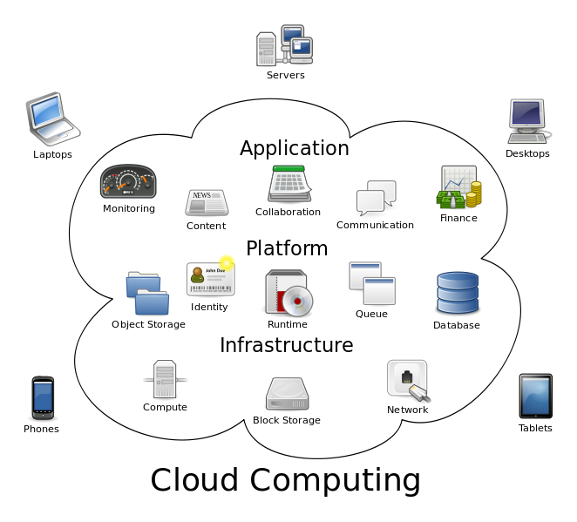
INTRODUCTION
Cloud computing is computation software, data access and storage services that do not require end-user knowledge of the physical location and the configuration of the system that delivers the services.

Slide 3
ABSTRACT
Placing critical data in the hands of a cloud provider should come with the guarantee of security and availability for data at rest, in motion, and in use.
We propose a novel architecture that integrates cloud database services with data confidentiality and the possibility of executing concurrent operations on encrypted data with the support geographically distributed clients.
The proposed architecture has the further advantage of eliminating intermediate proxies that limit the elasticity, availability, and scalability properties that are intrinsic in cloud-based solutions.
The efficacy of the proposed architecture is evaluated through theoretical analyses and extensive experimental results based on a prototype implementation subject to the TPC-C standard benchmark for different numbers of clients and network latencies.

Slide 4
EXISTING SYSTEM
Original plain data must be accessible only by trusted parties that do not include cloud providers, intermediaries, and Internet; in any untrusted context, data must be encrypted. Satisfying these goals has different levels of complexity depending on the type of cloud service.
There are several solutions ensuring confidentiality for the storage as a service paradigm, while guaranteeing confidentiality in the database as a service (DBaaS) paradigm is still an open research area.

Slide 5
DISADVANTAGES OF EXISTING SYSTEM
Cannot apply fully homomorphic encryption schemes because of their excessive computational complexity.
Several alternatives exist for storage services, while data confidentiality solutions for the database as a service paradigm are still immature.
No separation of metadata and data
No security for metadata

Slide 6
PROPOSED SYSTEM
We propose a novel architecture that integrates cloud database services with data confidentiality and the possibility of executing concurrent operations on encrypted data.
This is the first solution supporting geographically distributed clients to connect directly to an encrypted cloud database, and to execute concurrent and independent operations including those modifying the database structure.
The proposed architecture has the further advantage of eliminating intermediate proxies that limit the elasticity, availability, and scalability properties that are intrinsic in cloud-based solutions.
Secure DBaaS provides several original features that differentiate it from previous work in the field of security for remote database services.

Slide 7
ADVANTAGES OF PROPOSED SYSTEM
The proposed architecture does not require modifications to the cloud database, and it is immediately applicable to existing cloud DBaaS, such as the experimented PostgreSQL Plus Cloud Database, Windows Azure and Xeround .
There are no theoretical and practical limits to extend our solution to other platforms and to include new encryption algorithm.
It guarantees data confidentiality by allowing a cloud database server to execute concurrent SQL operations (not only read/write, but also modifications to the database structure) over encrypted data.
It provides the same availability, elasticity, and scalability of the original cloud DBaaS because it does not require any intermediate server.

Slide 8
SYSTEM ARCHITECTURE

Slide 9
SYSTEM REQUIREMENTS
HARDWARE REQUIREMENTS:
System : Pentium IV 2.4 GHz.
Hard Disk : 40 GB.
Monitor : 15 VGA Colour.
Ram : 512 Mb
SOFTWARE REQUIREMENTS:
Operating system : Windows XP/7.
Coding Language : ASP.net, C#.net
Tool : Visual Studio 2010
Database : SQL SERVER 2008

Slide 10
MODULES
Module 1: Setup Phase
Module 2: Meta Data Module
Module 3: Sequential SQL Operations
Module 4: Concurrent SQL Operations

Slide 11
Module 1: Setup Phase
We describe how to initialize a Secure DBaaS architecture from a cloud database service acquired by a tenant from a cloud provider.
We assume that the DBA creates the metadata storage table that at the beginning contains just the database metadata, and not the table metadata.
The DBA populates the database metadata through the Secure DBaaS client by using randomly generated encryption keys for any combinations of data types and encryption types, and stores them in the metadata storage table after encryption through the master key.
Then, the DBA distributes the master key to the legitimate users. User access control policies are administrated by the DBA through some standard data control language as in any unencrypted database.

Slide 12
Module 2: Meta Data Module
In this module, we develop Meta data. So our system does not require a trusted broker or a trusted proxy because tenant data and metadata stored by the cloud database are always encrypted.
Tenant data, data structures, and metadata must be encrypted before exiting from the client.
The information managed by SecureDBaaS includes plaintext data, encrypted data, metadata, and encrypted metadata.
SecureDBaaS clients produce also a set of metadata consisting of information required to encrypt and decrypt data as well as other administration information.

Slide 13
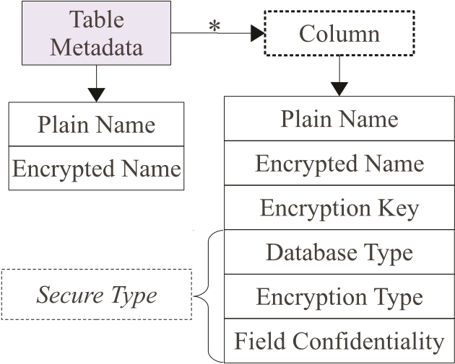
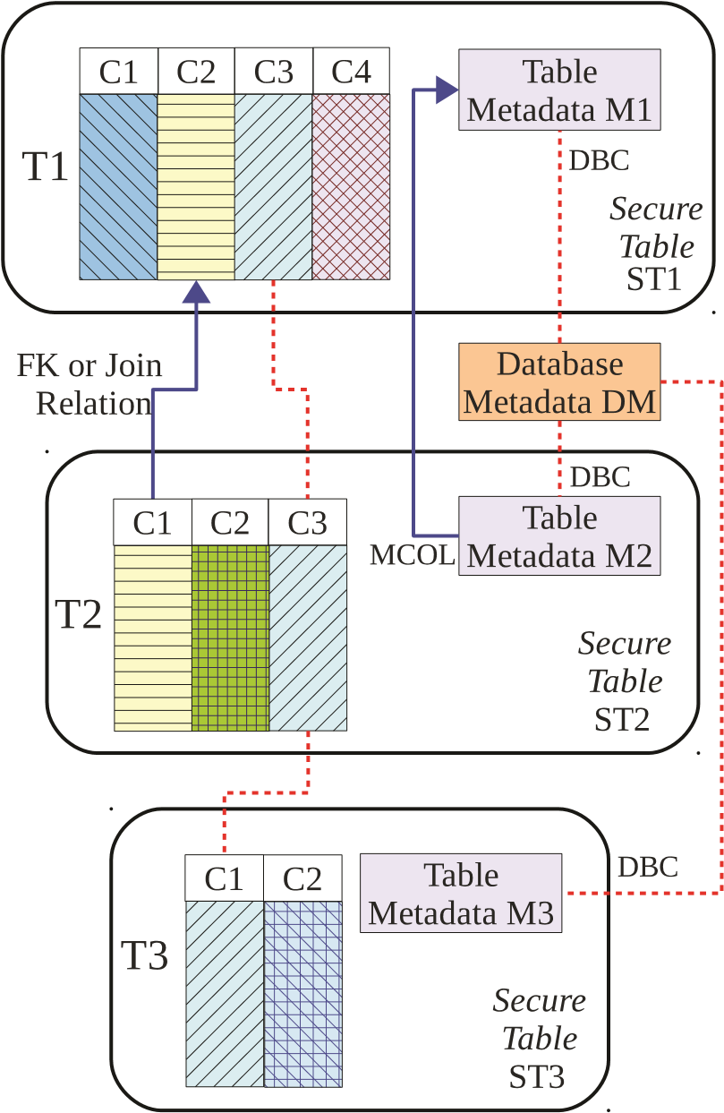
Fig: Management of the encryption keys according to the field
confidentiality parameter.
Fig: Structure of table metadata.

Slide 14
Module 3: Sequential SQL Operations
The first connection of the client with the cloud DBaaS is for authentication purposes. Secure DBaaS relies on standard authentication and authorization mechanisms pro-vided by the original DBMS server.
Secure DBaaS analyzes the original operation to identify which tables are involved and to retrieve their metadata from the cloud database.
The metadata are decrypted through the master key and their information is used to translate the original plain SQL into a query that operates on the encrypted database.

Slide 15
Module 4: Concurrent SQL Operations
The support to concurrent execution of SQL statements issued by multiple independent (and possibly geographically distributed) clients is one of the most important benefits of Secure DBaaS with respect to state-of-the-art solutions.
Our architecture must guarantee consistency among encrypted tenant data and encrypted metadata because corrupted or out-of-date metadata would prevent clients from decoding encrypted tenant data resulting in permanent data losses.
Here, we remark the importance of distinguishing two classes of statements that are supported by Secure DBaaS: SQL operations not causing modifications to the database structure, such as read, write, and update; operations involving alterations of the database structure through creation, removal, and modification of database tables (data definition layer operators).

Slide 16


